Slide 1
Azure Percept Bootcamp Solution Hack: Garment Counter
Presented By:
Rajesh Dhiman (rajesh.dhiman@capgemini.com)
Manan Shah (manan.a.shah@capgemini.com)
03-15-2022

Slide 2
Use Case
Vision Statement –
Theft Prevention: Count the garments taken by the customer to fitting room of a cloth retail store.
Analyze the tone (Lighter tone /Darker tone) of the garments picked by the customer.
Provide a predictive analysis to the garment designers, for color choices made by the customers for the region.

Slide 3
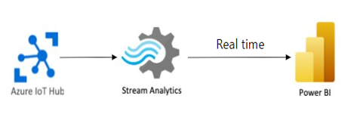
Azure Percept Reference Architecture
Outlining a high-level overview of the tools and services used within the solution
Eye Module, Speech Module and Custom Module on Edge Device
Azure resources, services and Power BI
Edge
Cloud
Eye Module
Custom Module
Garment Detection Model
Speech Module
Garment counting over custom commands model
Custom Commands
Azure Percept DK

Slide 4


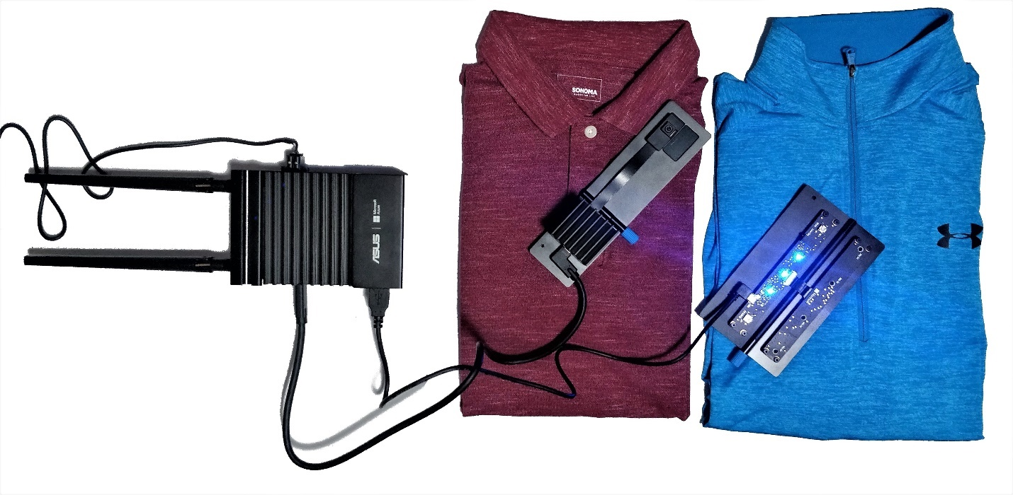

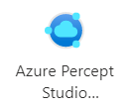





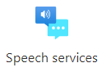
Azure Percept Reference Architecture (Detailed)
Speech & Ear Module
IOT Edge
Telemetry
Telemetry
Garment Counting Custom Module
Edge
Eye Module
IOT Hub
Live Telemetry
Edge Devices at Customer location
Telemetry
Devices
Vision Training
Vision Trained Model
Speech Trained Model
Custom
Commands
Azure Speech Studio
speech Training
Cloud

Slide 5
Implementation: Steps/ Results / Outcome
Solution Outline:
Voice commands to start and stop scanning.
Vision to detect and count the garment
Vision to detect the color tone
Run actuators to announce the garment count
Training of Model:
More than 250 images have been captured to train the model.
4 iterations have been executed for more precises identification and results
Model has been trained for voice action.
Speech Command: Start, Next and Stop

Slide 6
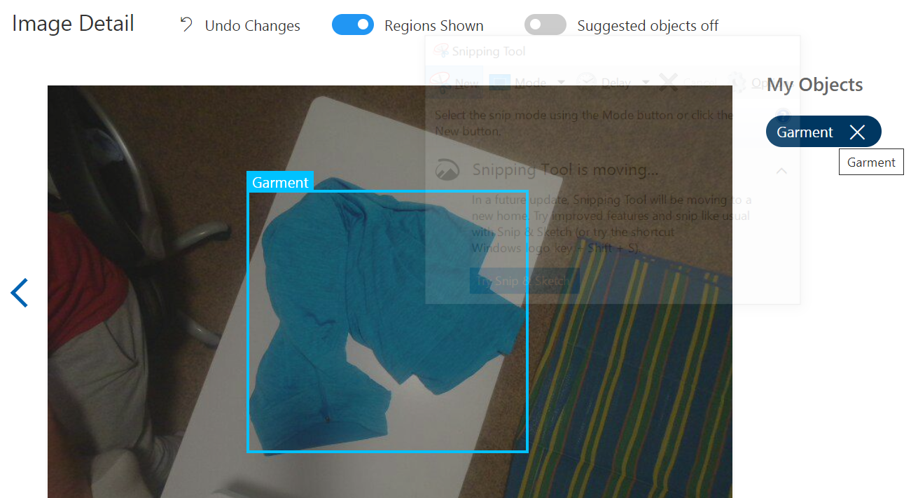
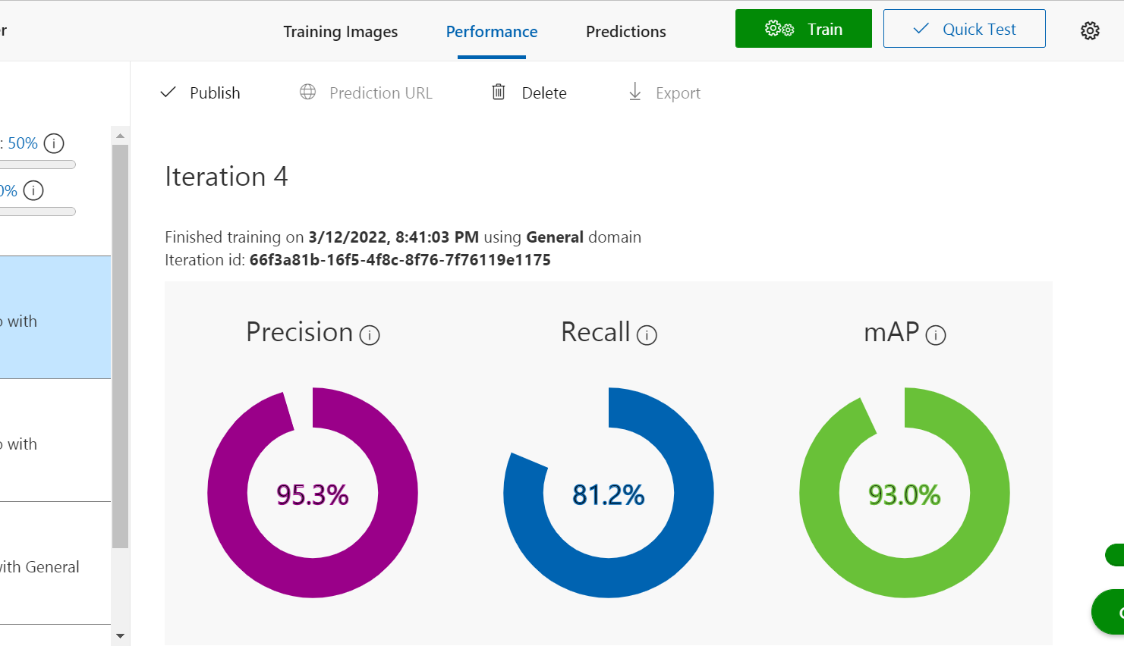
Implementation: Training/ Iterations

Slide 7
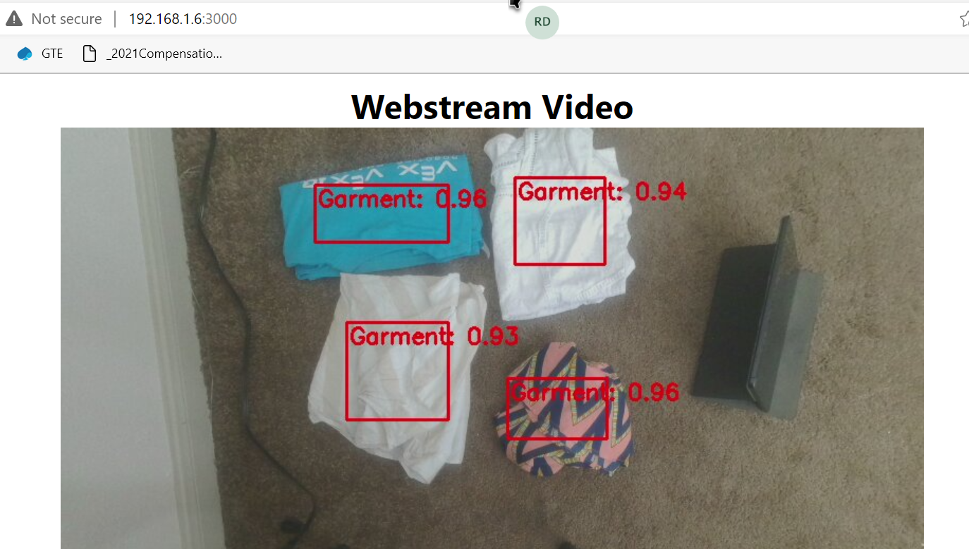
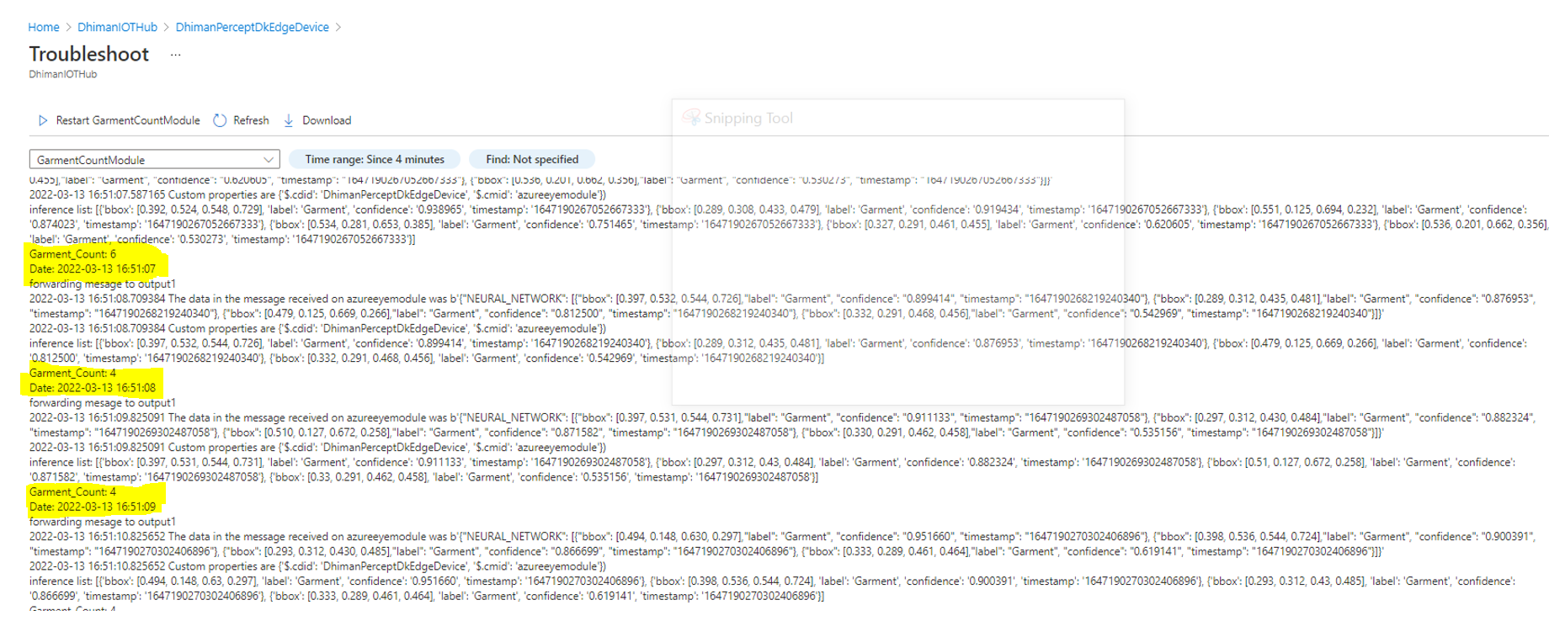
Implementation: Results/ Outcome

Slide 8
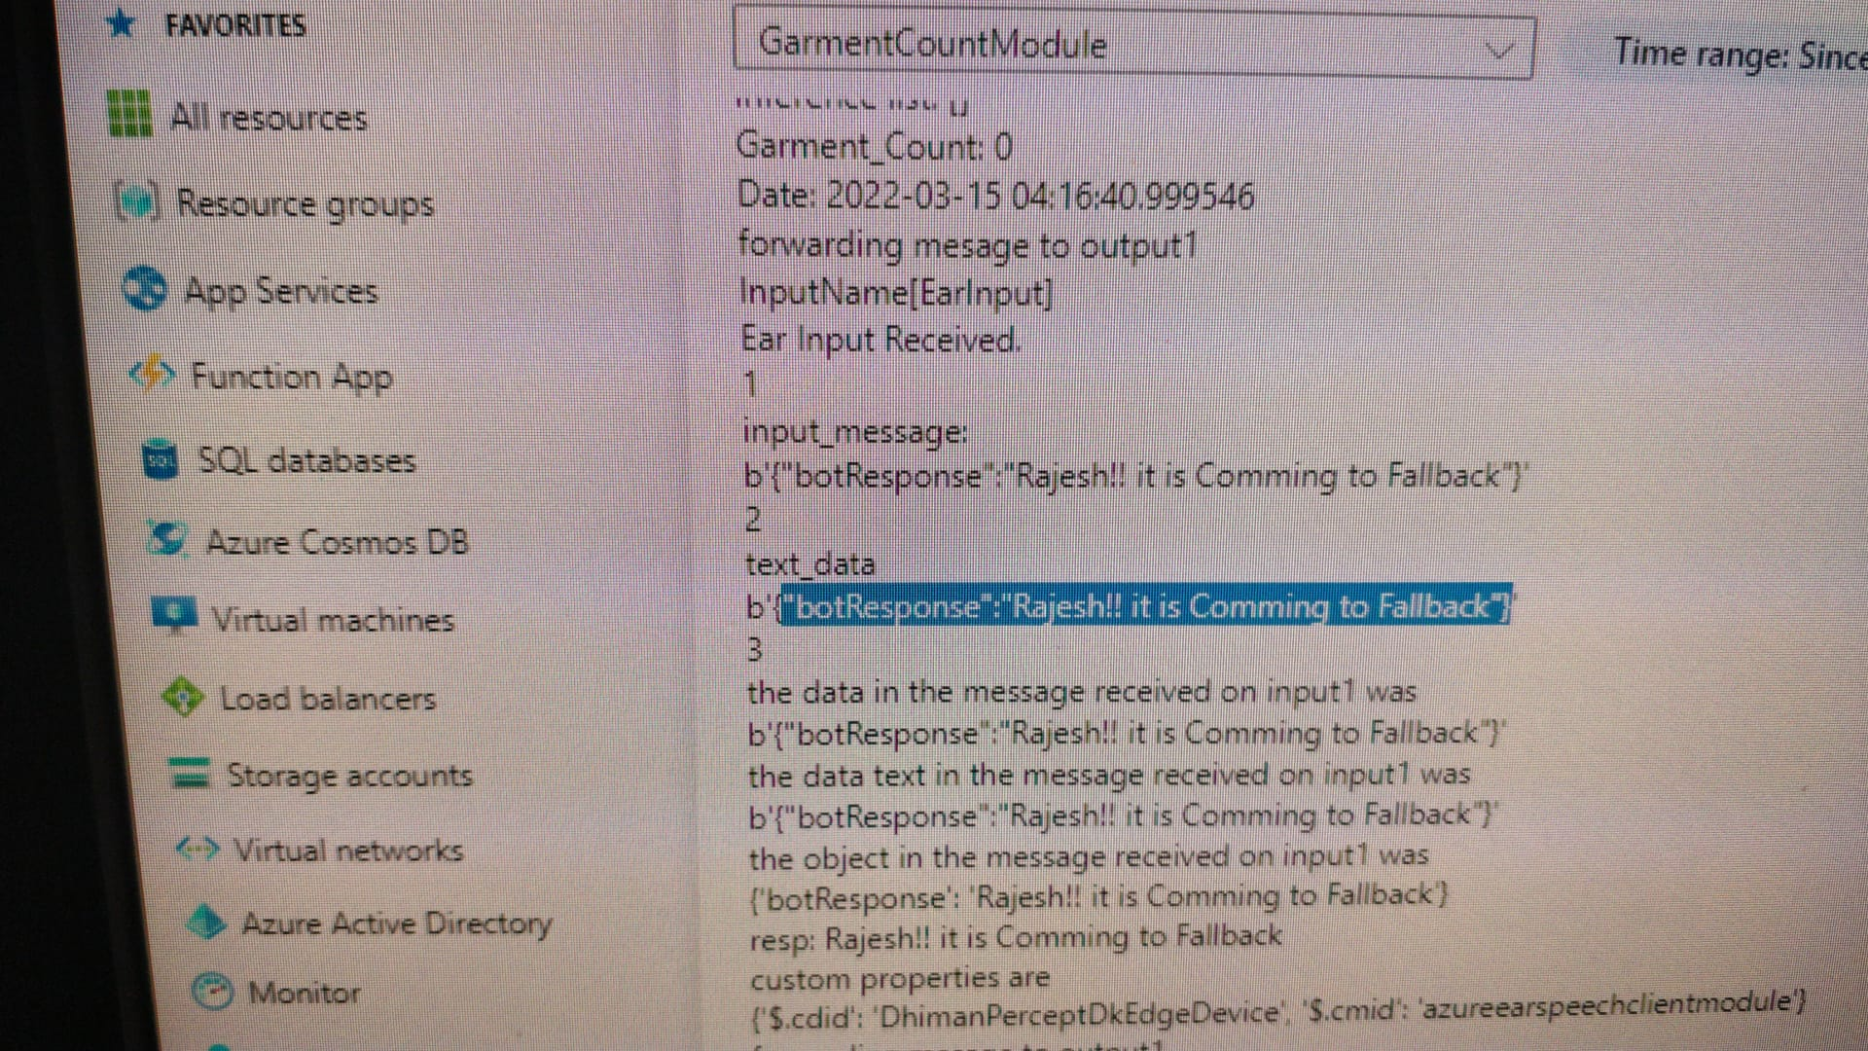
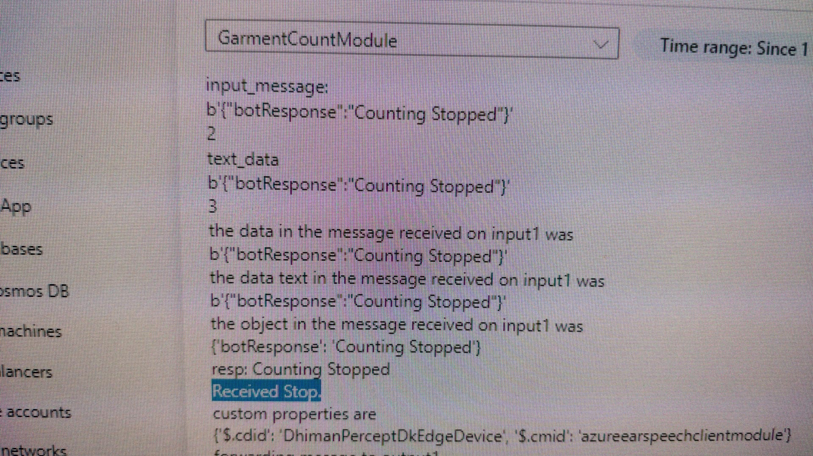
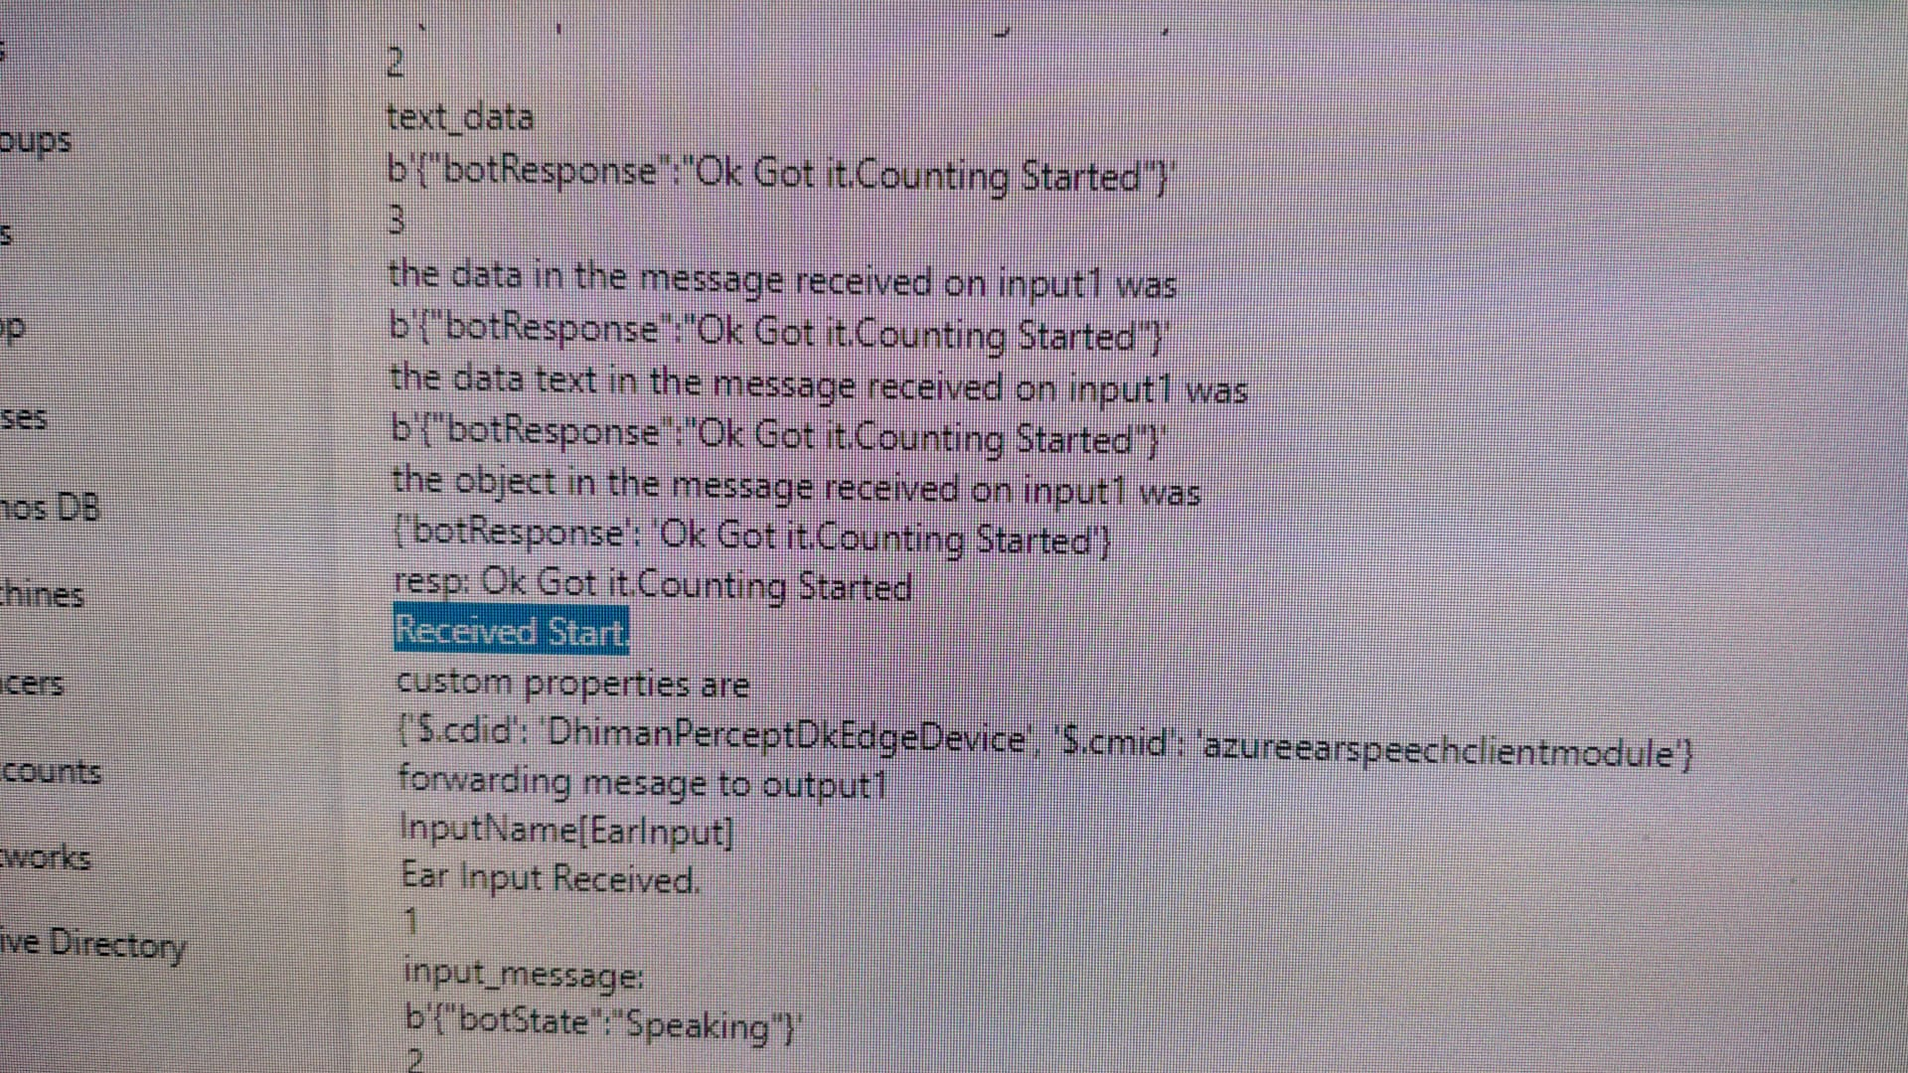
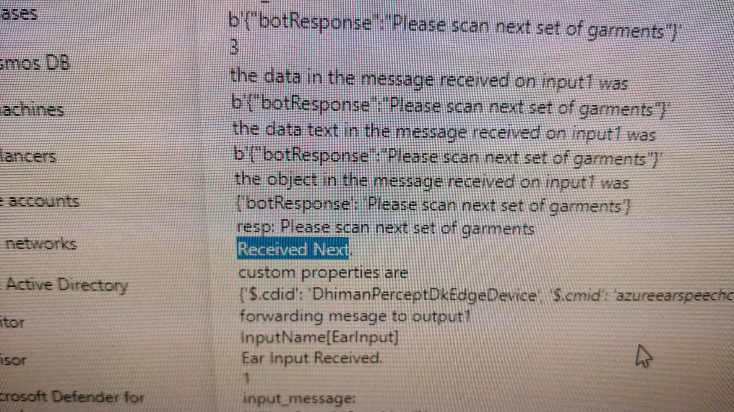
Implementation: Outcome – Ear Module

Slide 9
A Video
Garment Counter Solution Hack Video link:
https://www.youtube.com/watch?v=Faq5ofl4QVs

Slide 10
Next Steps
Current implementation and future enhancements–
Integrate speech module for voice commands (In progress)
Color tone training
Power BI representation of color tone selection trend
Greet the customer on their selection for trend, based on the color in fashion.

Slide 11
Thank you

